Slide 1
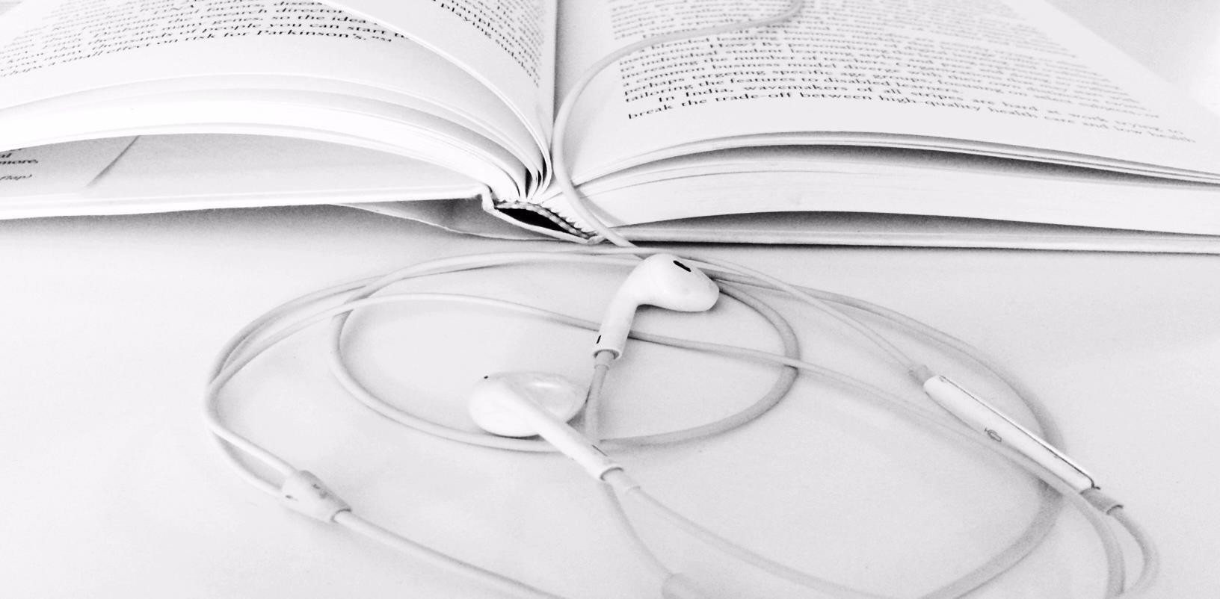
TEXT TO SPEECH FOR VISUALLY IMPAIRED PEOPLE
Guide : Ms. Rose Mary Mathew Scrum Master: Dr. Shahana KU
Student : Mohammed Shekeeb K S4-B 31

Slide 2

INTRODUCTION
Text-to-speech synthesis -TTS - is the automatic conversion of a text into speech that resembles, as closely as possible, a native speaker of the language reading that text. Text-to speech synthesizer (TTS) is the technology which lets computer speak to you. The TTS system gets the text as the input and then a computer algorithm which called TTS engine analyses the text, pre-processes the text and synthesizes the speech with some mathematical models. The TTS engine usually generates sound data in an audio format as the output.

Slide 3
OBJECTIVES
The objective of this project is to convert the text into voice by running
the program.
This project will be developed using pyttsx3(Python text to speech library).
In this project, we add a message which we want to convert into voice
and run the program to play the voice of that text message.
Importing the modules
Create the display window
Define functions

Slide 4
EXISTING SYSTEM
Existing system rely on predefined rules for pronunciation, intonation, and rhythm. They are efficient and work well for basic text conversion.
The speech generated can sound robotic or monotonous, lacking the natural inflections and nuances of human speech.
Options for personalizing voice characteristics or emotional expression are often
limited.
The quality of generated speech heavily depends on the size and quality of the training data.

Slide 5
PROPOSED SYSTEM
Proposed system use artificial neural networks to learn the intricacies of human
speech from vast amounts of data.
It can capture subtle variations in speech patterns, leading to more natural-sounding and expressive voices.
It may offer users more control over voice characteristics, pitch, and emotional tone
.

Slide 6
MODULE DESCRIPTION
Text Preprocessing:
Takes input text as a string.
Performs tasks like:
Normalization: Converts text to lowercase, removes punctuation, and handles special characters.
Text cleaning: Removes unwanted characters, typos, or grammatical errors (optional).
Text-to-Phoneme Conversion:
Converts each word into a sequence of phonemes (basic units of sound in a language).
May utilize pre-built dictionaries or machine learning models for pronunciation prediction.
3.Prosody Prediction:
Defines speech characteristics like:
Gender
Speed

Slide 7
Speech Synthesis:
Generates the audio waveform using the predicted phonemes and prosodic features.
Commonly employs various techniques like:
Waveform concatenation: Stitches together pre-recorded sounds of individual phonemes.
Parametric synthesis: Creates speech using mathematical models and parameters.
Deep learning-based synthesis: Utilizes neural networks to generate speech directly from text.
Audio Output:
Saves the generated audio file in a desired format (e.g., MP3).

Slide 8
TECHNOLOGIES
TOOLS
1.pyttsx3
It is a Python library that provides a simple and efficient interface for text-to-speech conversion. It
allows developers to easily incorporate speech synthesis capabilities into their Python applications.
The library supports multiple platforms and speech engines, enabling flexibility in choosing the desired voice and language for the synthesized speech.
Using this, developers can control various aspects of speech synthesis, such as speech rate, volume, and voice selection, to tailor the output according to specific requirements.
It offers asynchronous operation, allowing for concurrent text processing and speech synthesis, thus enhancing the responsiveness of applications.

Slide 9
2. PyPDF2
PyPDF2 is a Python library for working with PDF files which enables users to manipulate
existing PDF documents in various ways.
Functionality includes splitting, merging, cropping, rotating pages, and extracting text and metadata from PDFs.
Common tasks include extracting specific information from PDFs or merging multiple
PDFs into a single document.
It is an open-source library, freely available for use in Python projects.
PyPDF2 is widely used in Python projects where PDF handling is required.

Slide 10
FRONT END
1. Tkinter
Tkinter is the standard GUI (Graphical User Interface) toolkit for Python.
Tkinter provides a set of modules and classes that allow for the creation of windows,
buttons, labels, textboxes, and other GUI elements.
With Tkinter, developers can create interactive desktop applications with ease.
Tkinter is powerful and flexible, allowing for the creation of complex and visually appealing applications.
Tkinter is a versatile and reliable choice for developing GUI applications in Python.

Slide 11
OUTPUT

Slide 12
CONCLUSION
Text to speech synthesis is a rapidly growing aspect of computer technology and is increasingly playing a more important role in the way we interact with the system and interfaces across a variety of platforms. We have identified the various operations and processes involved in text to speech synthesis. We have also developed a very simple and attractive graphical user interface which allows the user to type in his/her text provided in the text field in the application. Our system interfaces with a text to speech engine developed for American English.

Slide 13
FUTURE SCOPE
Another area of further work is the implementation of a text to speech system on other platforms, such as telephony systems, ATM machines, video games and any other platforms where text to speech technology would be an added advantage and increase functionality.

Slide 14
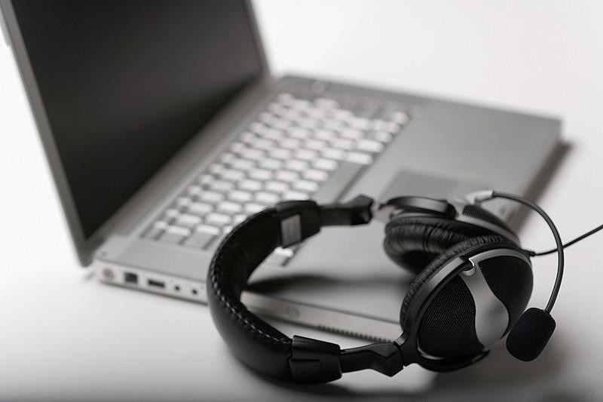
THANK YOU

